Slide 1
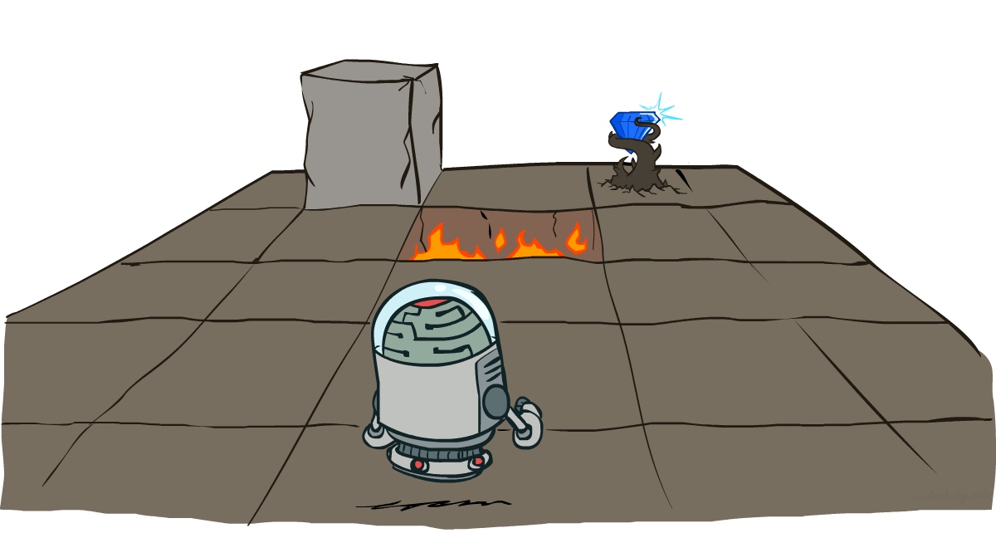
Reinforcement Learning
Markov Decision Processes
Instructor: Ngoc-Hoang LUONG, PhD.
[These slides were adapted from the slides created by Dan Klein and Pieter Abbeel for CS188 Intro to AI at UC Berkeley. http://ai.berkeley.edu.]
Notes:
Please retain proper attribution, including the reference to ai.berkeley.edu. Thanks!

Slide 2
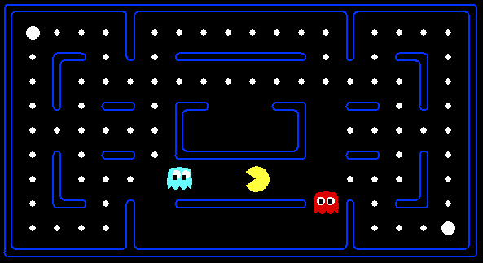
Behavior from Computation

Slide 3

Video of Demo Mystery Pacman

Slide 4

Adversarial Games

Slide 5
A simple game
You choose one of the three bins.
I choose a number from that bin.
Your goal is to maximize the chosen number.
A
-$50 $50
B
$1 $5
C
-$10 $20

Slide 6
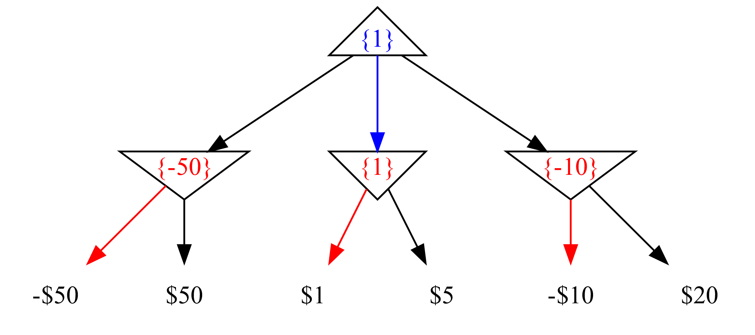
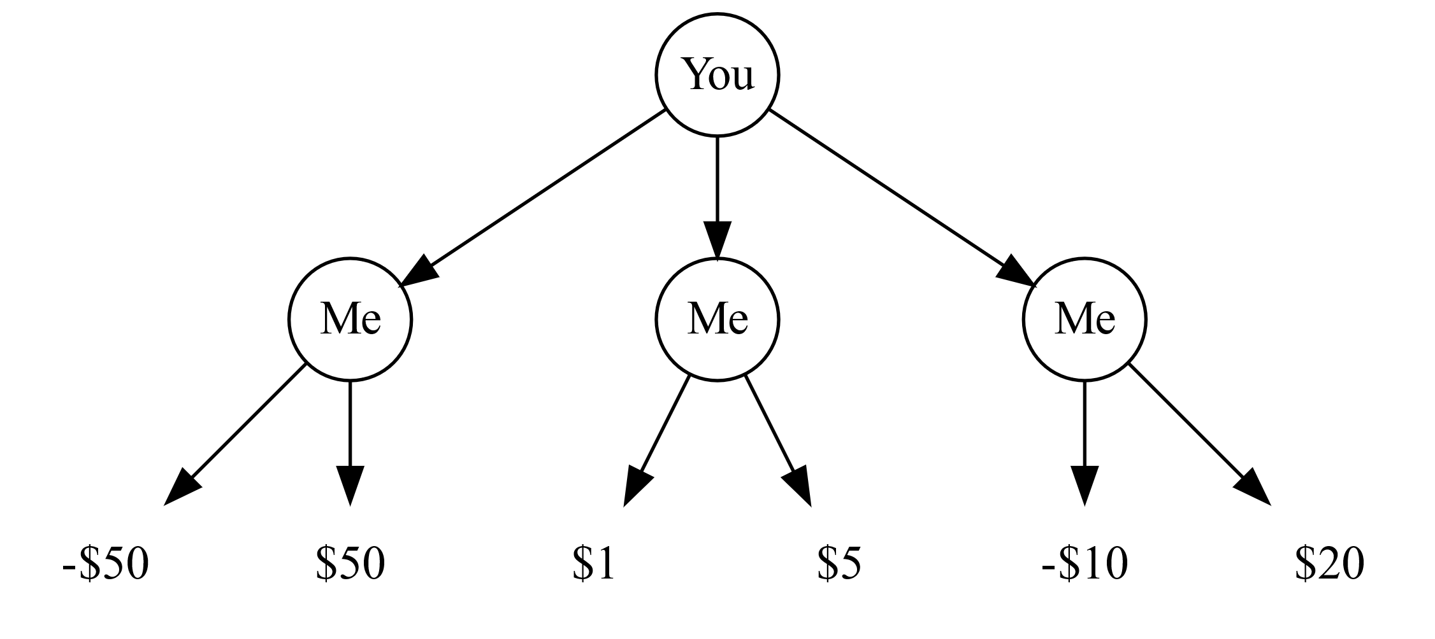
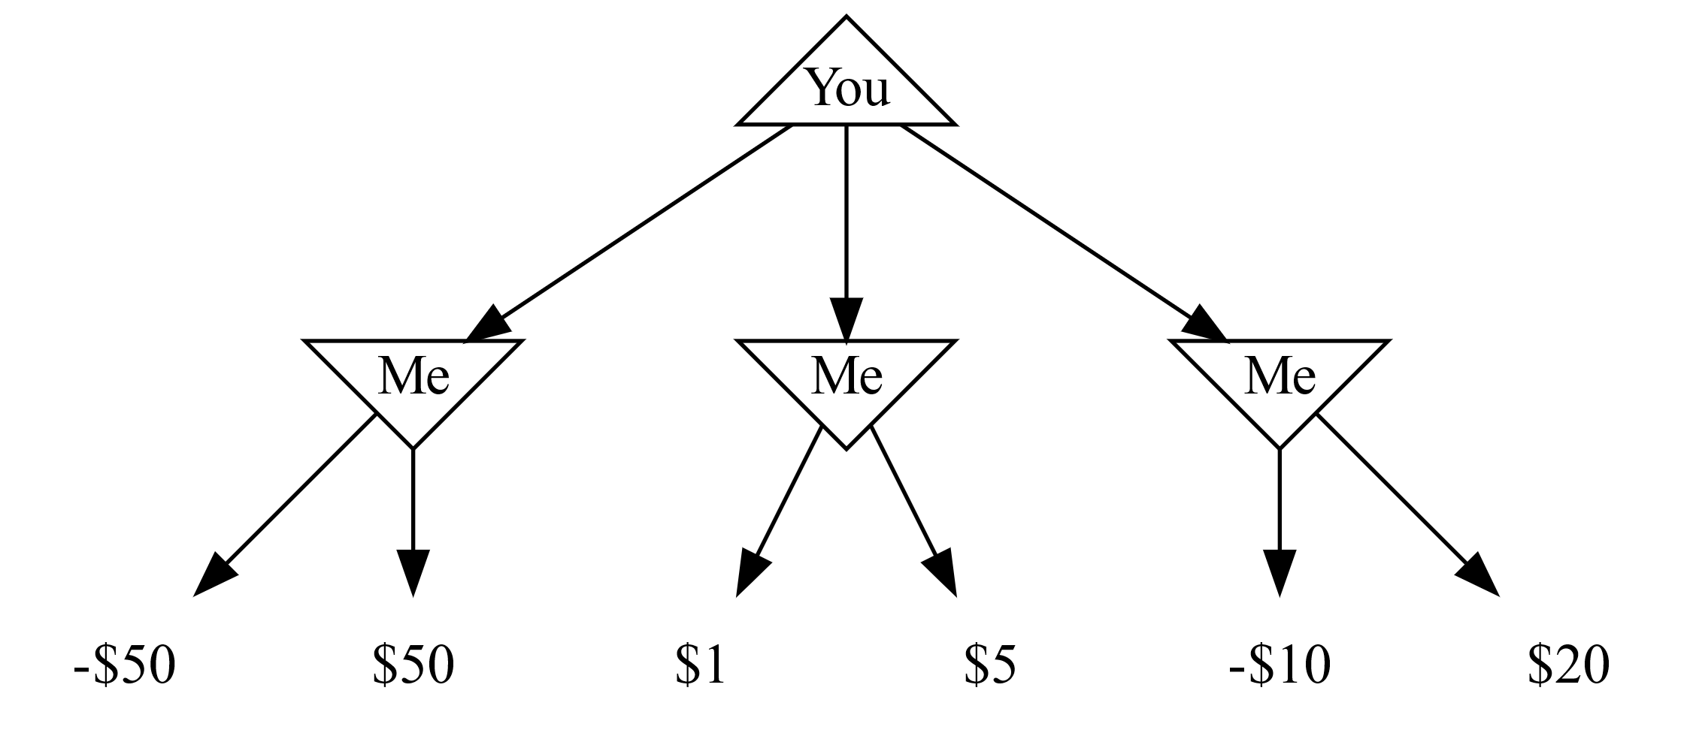
Game tree
Each node is a decision point for a player.
Each root-to-leaf path is a possible outcome of the game.
Your goal is to maximize the chosen number.

Slide 7

Adversarial Search

Slide 8
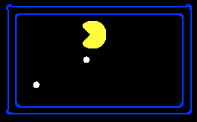
Single-Agent Trees
8
2
0
…
2
6
…
4
6

Slide 9
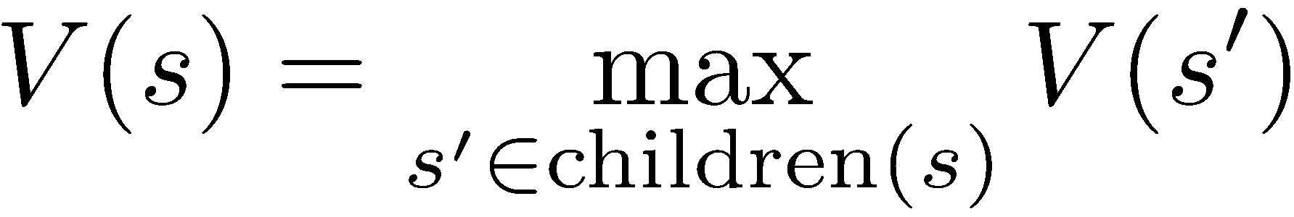

Value of a State
Value of a state: The best achievable outcome (utility) from that state
Non-Terminal States:
8
2
0
…
2
6
…
4
6
Terminal States:

Slide 10

Adversarial Game Trees
-20
-8
…
-18
-5
…
-10
+4
-20
+8

Slide 11
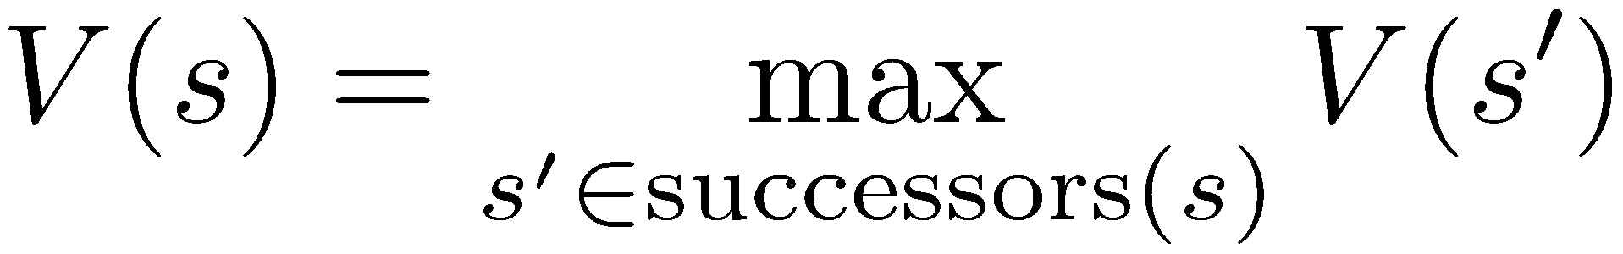
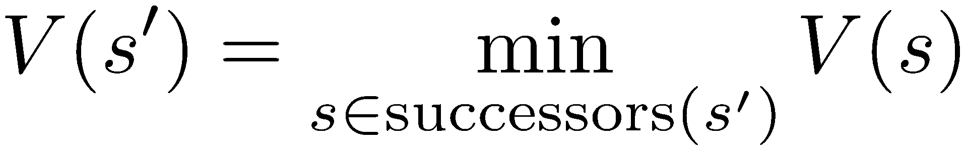
Minimax Values
States Under Agent’s Control:
States Under Opponent’s Control:
-8
-5
-10
+8
Terminal States:

Slide 12

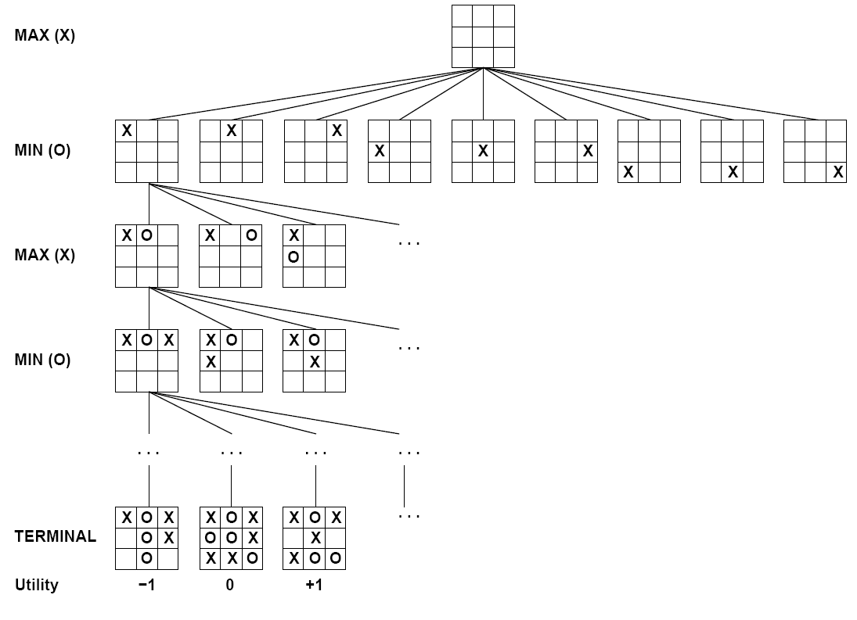

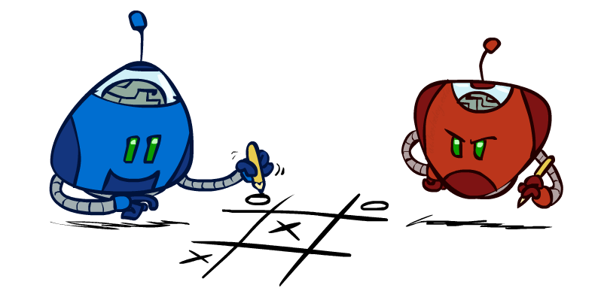
Tic-Tac-Toe Game Tree

Slide 13
X | O | X
O | O | X
X’s turn (MAX)
+1
X | O | X
O | O | X
X
X | O | X
O | O | X
 | X
X | O | X
O | O | X
 |  | X
O’s turn (MIN)
-1
0
+1
X | O | X
O | O | X
X | O
X | O | X
O | O | X
X |  | O
X | O | X
O | O | X
O | X
X | O | X
O | O | X
 | X | O
X’s turn (MAX)
-1
0
+1
0
X | O | X
O | O | X
X | X | O
X | O | X
O | O | X
O | X | X
X | O | X
O | O | X
X | X | O
0
+1
0

Slide 14
Adversarial Search (Minimax)
Deterministic, zero-sum games:
Tic-tac-toe, chess, checkers
One player maximizes result
The other minimizes result
Minimax search:
A state-space search tree
Players alternate turns
Compute each node’s minimax value: the best achievable utility against a rational (optimal) adversary
Minimax values: computed recursively
5
max
2
5
min
8
2
5
6
Terminal values: part of the game

Slide 15
Minimax Efficiency
How efficient is minimax?
Just like (exhaustive) DFS
Time: O(b^{m})
Space: O(bm)
Example: For chess, b ≈ 35, m ≈ 100
Exact solution is completely infeasible
But, do we need to explore the whole tree?

Slide 16

Resource Limits

Slide 17
Resource Limits
Problem: In realistic games, cannot search to leaves!
Solution: Depth-limited search
Instead, search only to a limited depth in the tree
Replace terminal utilities with an evaluation function for non-terminal positions
Example:
Suppose we have 100 seconds, can explore 10K nodes / sec
So can check 1M nodes per move
α-β reaches about depth 8 – decent chess program
Guarantee of optimal play is gone
More plies makes a BIG difference
Use iterative deepening for an anytime algorithm
max
4
-2
4
min
-1
-2
4
9
?
?
?
?

Slide 18
Evaluation Functions
Evaluation functions score non-terminals in depth-limited search
Ideal function: returns the actual minimax value of the position
In practice: typically weighted linear sum of features:
e.g. f₁(s) = (num white queens – num black queens), etc.

Slide 19
Video of Demo Limited Depth (2)

Slide 20
Video of Demo Limited Depth (10)

Slide 21
Iterative Deepening
Iterative deepening uses DFS as a subroutine:
Do a DFS which only searches for paths of length 1 or less. (DFS gives up on any path of length 2)
If “1” failed, do a DFS which only searches paths of length 2 or less.
If “2” failed, do a DFS which only searches paths of length 3 or less.
….and so on.
Why do we want to do this for multiplayer games?
Note: wrongness of eval functions matters less and less the deeper the search goes!
b
…

Slide 22
Minimax Properties
You choose one of the three bins.
I toss a fair coin. If head, the bigger number is returned. If tail, the smaller number is returned.
Your goal is to maximize the chosen number.
A
-$50 $50
B
$1 $5
C
-$10 $20

Slide 23
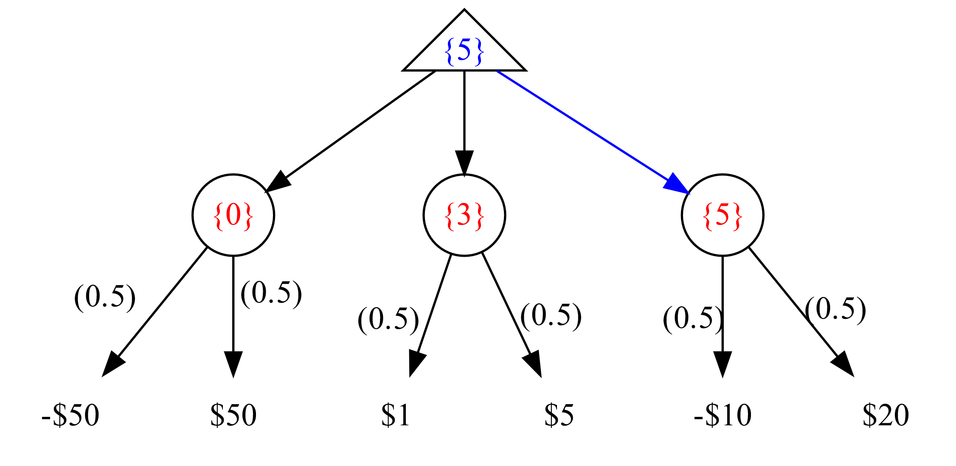
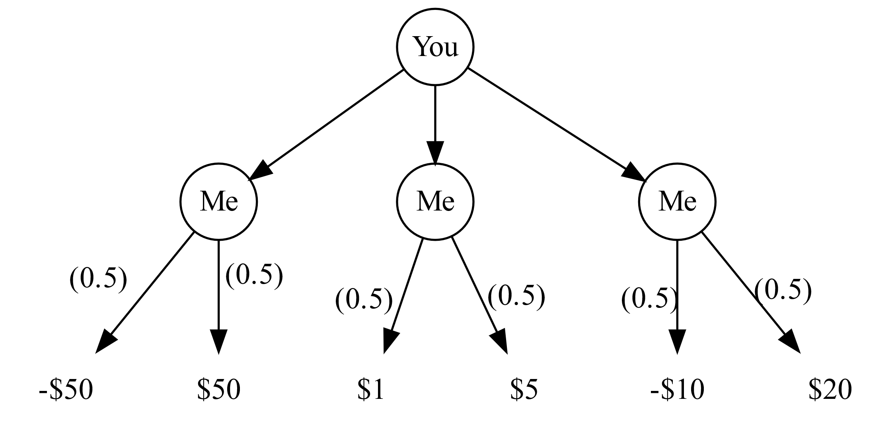
Minimax Properties
You choose one of the three bins.
I toss a fair coin. If head, the bigger number is returned. If tail, the smaller number is returned.
Your goal is to maximize the chosen number.

Slide 24
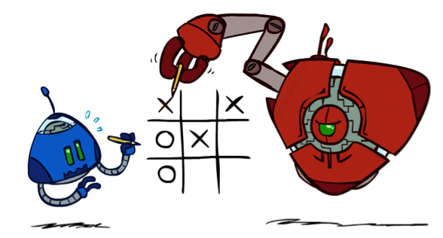

Minimax Properties
max
min
10
10
9
100
Optimal against a perfect player. Otherwise?
[Demo: min vs exp (L6D2, L6D3)]

Slide 25
Video of Demo Min vs. Exp (Min)

Slide 26
Video of Demo Min vs. Exp (Exp)

Slide 27
Expectimax Search
Why wouldn’t we know what the result of an action will be?
Explicit randomness: rolling dice
Unpredictable opponents: the ghosts respond randomly
Actions can fail: when moving a robot, wheels might slip
Values should now reflect average-case (expectimax) outcomes, not worst-case (minimax) outcomes
Expectimax search: compute the average score under optimal play
Max nodes as in minimax search
Chance nodes are like min nodes but the outcome is uncertain
Calculate their expected utilities
I.e. take weighted average (expectation) of children
Later, we’ll learn how to formalize the underlying uncertain-result problems as Markov Decision Processes
max
chance
10
10
4
10
5
9
7
100

Slide 28
Expectimax Example
8
8
4
7
3
12
9
2
4
6
15
6
0

Slide 29
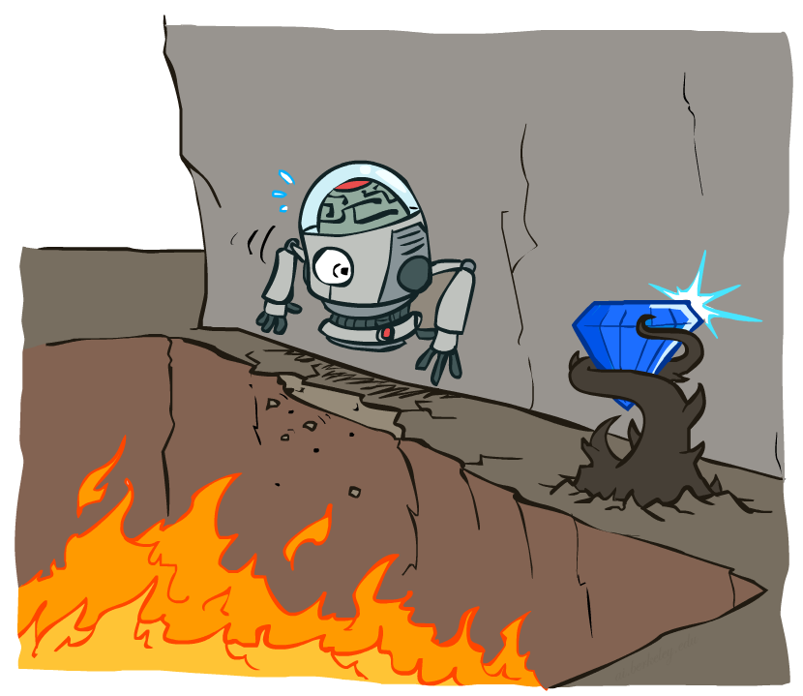
Non-Deterministic Search

Slide 30





Example: Grid World
A maze-like problem
The agent lives in a grid
Walls block the agent’s path
Noisy movement: actions do not always go as planned
80% of the time, the action North takes the agent North (if there is no wall there)
10% of the time, North takes the agent West; 10% East
If there is a wall in the direction the agent would have been taken, the agent stays put
The agent receives rewards each time step
Small “living” reward each step (can be negative)
Big rewards come at the end (good or bad)
Goal: maximize sum of rewards
Notes:
[cut demo of moving around in grid world program]

Slide 31
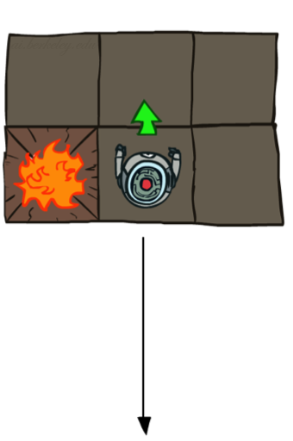
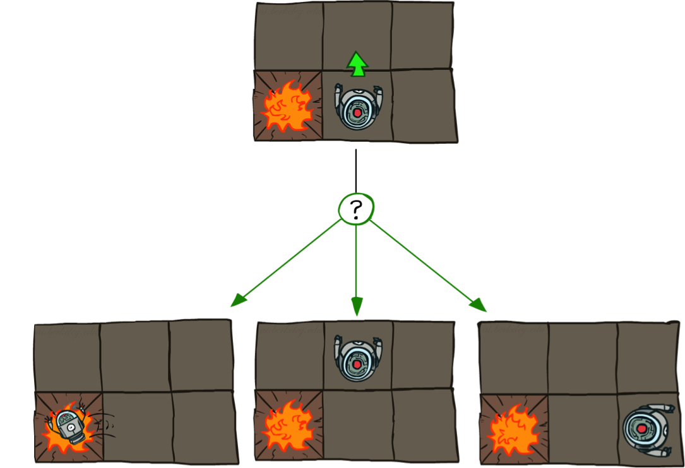

Grid World Actions
Deterministic Grid World
Stochastic Grid World

Slide 32
Markov Decision Processes
An MDP is defined by:
A set of states s ∈ S
A set of actions a ∈ A
A transition function T(s, a, s’)
Probability that a from s leads to s’, i.e., P(s’| s, a)
Also called the model or the dynamics
A reward function R(s, a, s’)
Sometimes just R(s) or R(s’)
A start state
Maybe a terminal state
MDPs are non-deterministic search problems
One way to solve them is with expectimax search
We’ll have a new tool soon
Notes:
In search problems: did not talk about actions, but about successor functions --- now the information inside the successor function is unpacked into actions, transitions and reward
Write out S, A, example entry in T, entry in R
Reward function different from the book : R(s,a,s’)
In book simpler for equations, but not useful for the projects.
Need to modify expectimax a tiny little bit to account for rewards along the way, but that’s something you should be able to do, and so you can already solve MDP’s (not in most efficient way)

Slide 33


What is Markov about MDPs?
“Markov” generally means that given the present state, the future and the past are independent
For Markov decision processes, “Markov” means action outcomes depend only on the current state
Andrey Markov (1856-1922)
Notes:
Like search: successor function only depended on current state
Can make this happen by stuffing more into the state;
Very similar to search problems: when solving a maze with food pellets, we stored which food pellets were eaten

Slide 34

Policies
In deterministic single-agent search problems, we wanted an optimal plan, or sequence of actions, from start to a goal
A policy π: S → A gives an action for each state.
E.g, π((1,1)) = “north”, π((4,1)) = “west”, π((3,3))=“east”, π((3,2))=“north”,…
For MDPs, we want an optimal policy π*: S → A
An optimal policy is one that maximizes expected utility if followed
Optimal policy when R(s, a, s’) = -0.03 for all non-terminals s
Notes:
Dan has a DEMO for this.

Slide 35
Policy
(3,3)
(1,1)
(4,1)

Slide 36

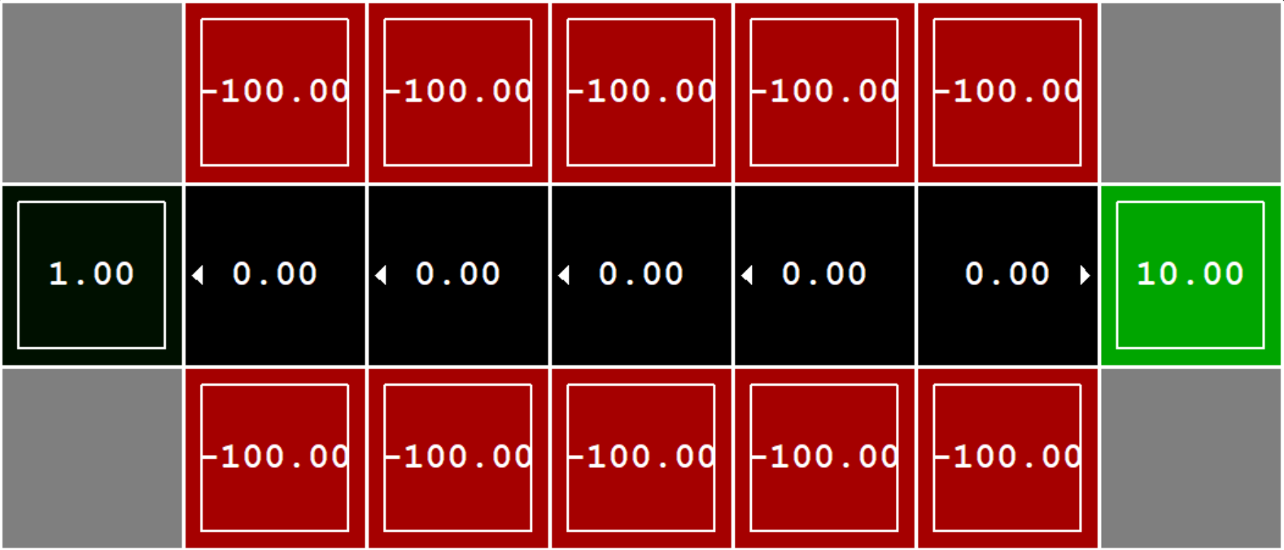

Example: Bridge Crossing

Slide 37


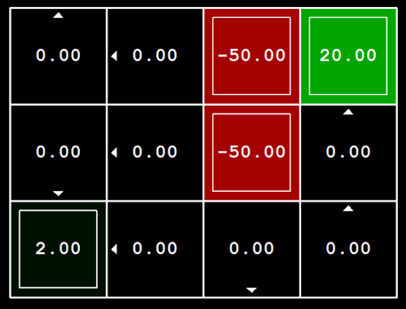

Example: Volcano
123RF.com
shutterstock.com

Slide 38
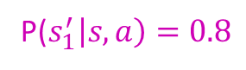
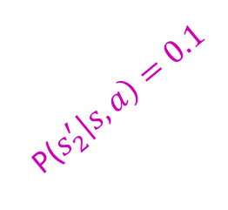
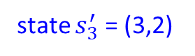
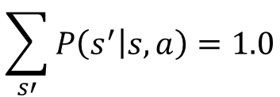
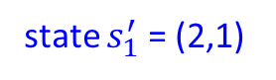
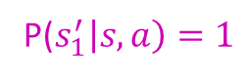
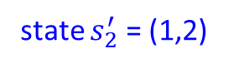
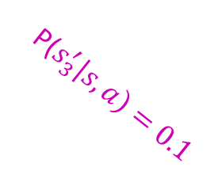
MDP Search Tree
state $s_{2}^{′}$ = (1,2)
state s = (2,2)
P($s_{2}^{′}\left|s,a\right)=0.1$
P($s_{1}^{′}\left|s,a\right)=1$
action a = “south”
P($s_{1}^{′}\left|s,a\right)=0.8$
state $s_{1}^{′}$ = (2,1)
P($s_{3}^{′}\left|s,a\right)=0.1$
$$\sum_{s′}{P\left(s^{′} | s,a\right)=1.0}$$
state $s_{3}^{′}$ = (3,2)

Slide 39
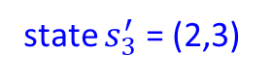
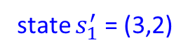

MDP Search Tree
state $s_{2}^{′}$ = (2,1)
state s = (2,2)
P($s_{2}^{′}\left|s,a\right)=0.1$
action a = “east”
P($s_{1}^{′}\left|s,a\right)=0.8$
state $s_{1}^{′}$ = (3,2)
P($s_{3}^{′}\left|s,a\right)=0.1$
$$\sum_{s′}{P\left(s^{′} | s,a\right)=1.0}$$
state $s_{3}^{′}$ = (2,3)

Slide 40
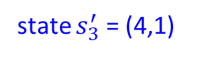
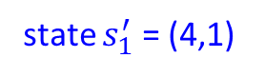
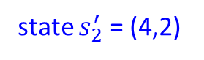
MDP Search Tree
state $s_{2}^{′}$ = (4,2)
state s = (4,1)
P($s_{2}^{′}\left|s,a\right)=0.1$
action a = “east”
P($s_{1}^{′}\left|s,a\right)=0.8$
state $s_{1}^{′}$ = (4,1)
P($s_{3}^{′}\left|s,a\right)=0.1$
$$\sum_{s′}{P\left(s^{′} | s,a\right)=1.0}$$
state $s_{3}^{′}$ = (4,1)

Slide 41


MDP Search Trees
Each MDP state projects an expectimax-like search tree
s
s is a state
a
(s, a) is a q-state
s, a
(s,a,s’) called a transition
T(s,a,s’) = P(s’|s,a)
R(s,a,s’)
s,a,s’
s’
Notes:
In MDP chance node represents uncertainty about what might happen based on (s,a) [as opposed to being a random adversary]
Q-state (s,a) is when you were in a state and took an action

Slide 42
Optimal Policies
R(s) = -0.01
R(s) = -0.03
R(s) = -0.4
R(s) = -2.0
R(s) = the “living reward”
Notes:
R(s) = the “living reward”

Slide 43

Policy Evaluation

Slide 44
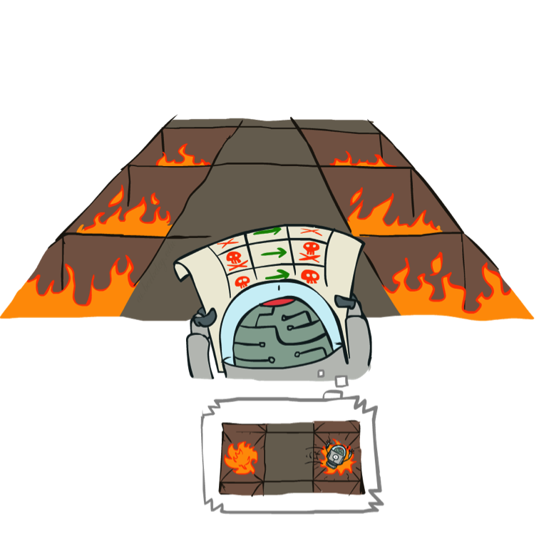
Example: Policy Evaluation
Always Go Right
Always Go Forward

Slide 45
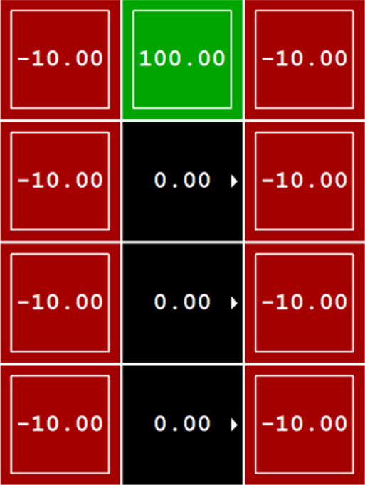
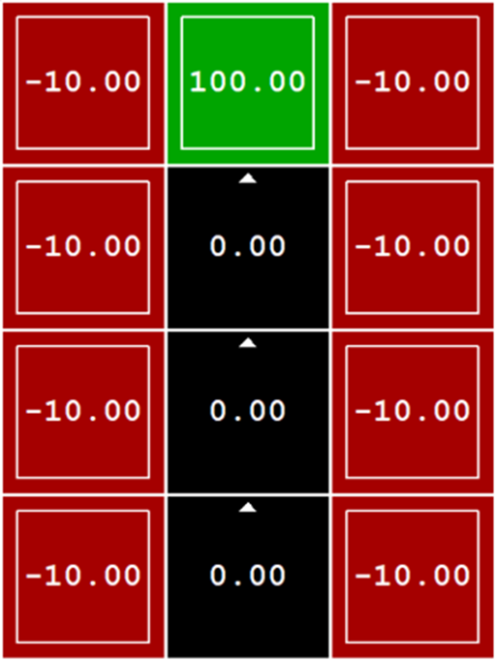
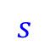
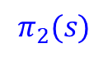
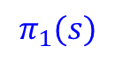
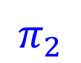
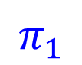
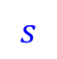
Example: Policy Evaluation
$$π_{1}$$
$$π_{2}$$
$$s$$
$$π_{1}(s)$$
$$s$$
$$π_{2}(s)$$
State | Action
(2,1) | “east”
(2,2) | “east”
(2,3) | “east”
(2,4) | “exit”
(1,3) | “exit”
… | …
State | Action
(2,1) | “north”
(2,2) | “north”
(2,3) | “north”
(2,4) | “exit”
(1,3) | “exit”
… | …

Slide 46
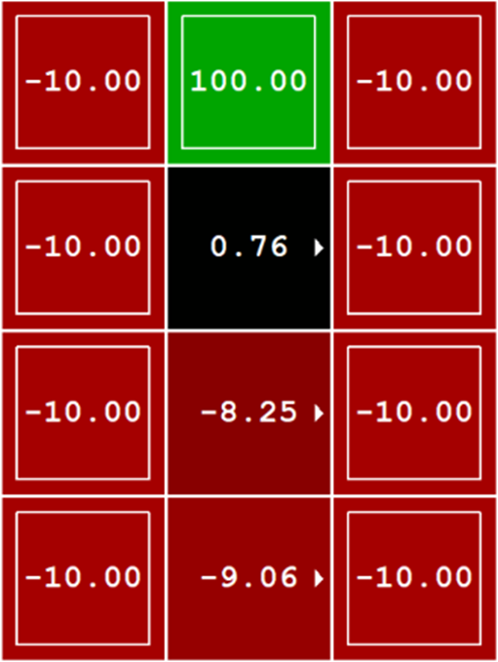
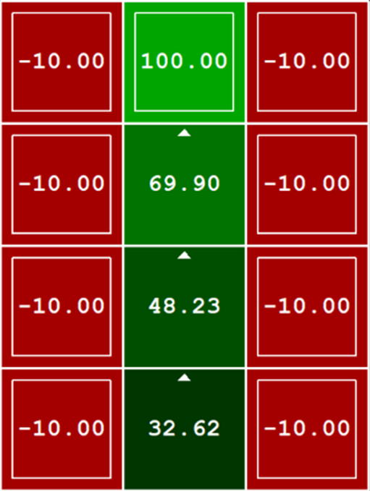


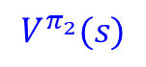
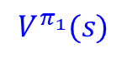
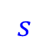
Example: Policy Evaluation
$$π_{1}$$
$$π_{2}$$
$$s$$
$$π_{1}(s)$$
$$V^{π_{1}}(s)$$
$$s$$
$$π_{2}(s)$$
$$V^{π_{2}}(s)$$
State | Action | Value
(2,1) | “east” | -9.06
(2,2) | “east” | -8.25
(2,3) | “east” | 0.76
(2,4) | “exit” | 100
(1,3) | “exit” | -10
… | … | …
State | Action | Value
(2,1) | “north” | 32.62
(2,2) | “north” | 48.23
(2,3) | “north” | 69.60
(2,4) | “exit” | 100
(1,3) | “exit” | -10
… | … | …
$$≤$$

Slide 47
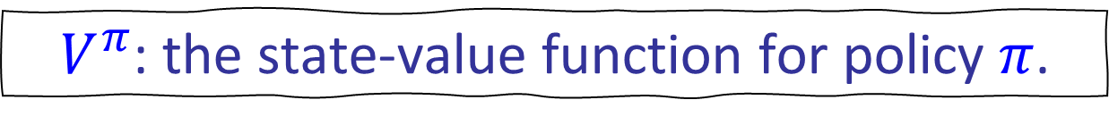
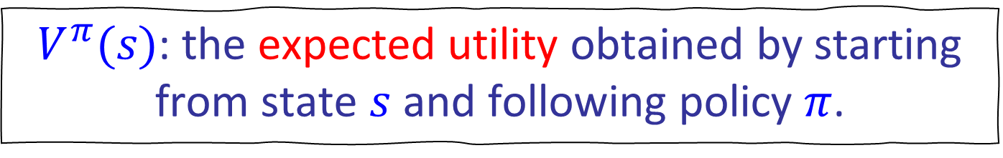
Policy Evaluation
$V^{π}(s)$: the expected utility obtained by starting from state $s$ and following policy $π$.
$V^{π}$: the state-value function for policy $π$.
$π_{2}≥π_{1}$ if and only if $V^{π_{2}}(s)≥V^{π_{1}}(s)$, for all $s∈S$.

Slide 48

Utility of a sequence of actions
Exit
Living Reward = 0, Noise = 0
$$U=0+0+\left(0+0.5\right)+0+0+0+20=20.5$$
$$U=\left(0+0.5\right)+0+0+0+\left(0+0.5\right)+0+0+0+20=21$$

Slide 49

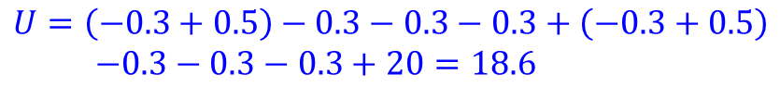
Utility of a sequence of actions
Exit
Living Reward = -0.3, Noise = 0.0
$$U=−0.3−0.3+\left(−0.3+0.5\right)−0.3−0.3−0.3+20=18.7$$
$$U=\left(−0.3+0.5\right)−0.3−0.3−0.3+\left(−0.3+0.5\right)$$ $−0.3−0.3−0.3+20=18.6$
Utility $\sim$ Sum of Rewards

Slide 50

Utility of a sequence of actions
Exit
Living Reward = -0.3, Noise = 0.2
Exit
$$U=−0.3−0.3+\left(−0.3+0.5\right)−0.3−0.3−0.3+20=18.7$$
$$U=−0.3−0.3+\left(−0.3+0.5\right)−0.3−50=−50.7$$
$$U=−0.3−0.3−50=−50.6$$
Expected Utility $\sim$ Average Sum of Rewards
Utility $\sim$ Sum of Rewards

Slide 51
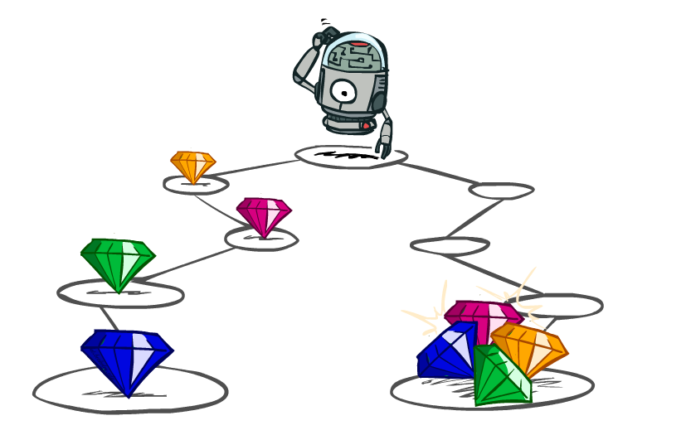
Utilities of Sequences

Slide 52
Utilities of Sequences
What preferences should an agent have over reward sequences?
More or less?
Now or later?
[1, 2, 2]
or
[2, 3, 4]
[0, 0, 1]
or
[1, 0, 0]

Slide 53




Discounting
It’s reasonable to maximize the sum of rewards
It’s also reasonable to prefer rewards now to rewards later
One solution: values of rewards decay exponentially
Worth Now
Worth Next Step
Worth In Two Steps

Slide 54

Discounting
How to discount?
Each time we descend a level, we multiply in the discount once
Why discount?
Sooner rewards probably do have higher utility than later rewards
Also helps our algorithms converge
Example: discount of 0.5
U([1,2,3]) = 1*1 + 0.5*2 + 0.25*3
U([1,2,3]) < U([3,2,1])
Notes:
Rewards in the future (deeper in the tree) matter less
Interesting: running expectimax, if having to truncate the search, then not losing much; e.g., less then \gamma^d / (1-\gamma)

Slide 55

Stationary Preferences
There are two ways to define utilities
Additive utility:
Discounted utility:

Slide 56



Infinite Utilities?!
Problem: What if the game lasts forever? Do we get infinite rewards?
Solutions:
Finite horizon: (similar to depth-limited search)
Terminate episodes after a fixed T steps (e.g. life)
Gives nonstationary policies (π depends on time left)
Discounting: use 0 < γ < 1
Geometric series $1+{\text{γ}}^{1}+{\text{γ}}^{2}+{\text{γ}}^{3}+…=\frac{1}{1−\text{γ}}$
Smaller γ means smaller “horizon” – shorter term focus
Absorbing state: guarantee that for every policy, a terminal state will eventually be reached.

Slide 57


Utility of a sequence of actions
Exit
Living Reward = -0.3, Noise = 0.0
$$U=\left(−0.3\right)+\left(0.9\right)×\left(−0.3\right)+{\left(0.9\right)}^{2}×\left(−0.3+0.5\right) \\ +{\left(0.9\right)}^{3}×\left(−0.3\right)+{\left(0.9\right)}^{4}×\left(−0.3\right)+{\left(0.9\right)}^{5}×\left(−0.3\right)$$ $+{\left(0.9\right)}^{6}×20=9.628$
$$U=\left(−0.3\right)+\left(0.9\right)×2=1.5$$
Exit
Utility $\sim$ Sum of Discounted Rewards
Utility $\sim$ Sum of Rewards

Slide 58





Utility of a sequence of actions
Living Reward = -0.3, Noise = 0.2
Exit
Exit
$$U=\left(−0.3\right)+\left(0.9\right)×\left(−0.3\right)+{\left(0.9\right)}^{2}×\left(−0.3+0.5\right) \\ +{\left(0.9\right)}^{3}×\left(−0.3\right)+{\left(0.9\right)}^{4}×\left(−0.3\right)+{\left(0.9\right)}^{5}×\left(−0.3\right)$$ $+{\left(0.9\right)}^{6}×20=9.628$
$$U=\left(−0.3\right)+\left(0.9\right)×\left(−0.3\right)+{\left(0.9\right)}^{2}×\left(−0.3+0.5\right) \\ +{\left(0.9\right)}^{3}×\left(−0.3\right)+{\left(0.9\right)}^{4}×\left(−50\right)=−33.432$$
Exit
$$U=\left(−0.3\right)+\left(0.9\right)×\left(−0.3\right)+{\left(0.9\right)}^{2}×\left(−50\right)=−41.07$$
$$U=\left(−0.3\right)+\left(0.9\right)×\left(2\right)=1.5$$
Exit
$$U=\left(−0.3+0.5\right)+\left(0.9\right)×\left(−0.3\right)+{\left(0.9\right)}^{2}×\left(−0.3\right) \\ +{\left(0.9\right)}^{3}×\left(−50\right)=−36.763$$
Expected Utility $\sim$ Average Sum of Discounted Rewards
Utility $\sim$ Sum of Discounted Rewards

Slide 59
Solving MDPs

Slide 60

Policy Evaluation

Slide 61

Policy Evaluation
Regarding the current state, how good is it according to a policy π?
state s = (2,2)

Slide 62























Policy Evaluation
$$\sum_{s′}{P\left(s^{′} | s,a\right)=1.0}$$
$$V^{π}\left(s\right)$$
expected utility of state s=(2,2) by following 𝜋
state $s_{2}^{′}$ = (1,2)
expected utility of state (1,2) by following 𝜋
expected utility of state (1,2)
$$=\sum_{s′}{P\left(s^{′} | s,\text{π}(s)\right)[R\left(s,\text{π}(s),s^{′}\right)+γV^{π}\left(s′\right)]}$$
$$V^{π}\left(s\right)$$
$$V^{π}\left(s\right)= Q^{π}\left(s,π(s)\right)$$
$V^{π}(s_{2}^{′}$)
$$P(s_{2}^{′}\left|s,a\right)=0.1$$
state s = (2,2)
$$R\left(s,a,s_{2}^{′}\right)=−0.3+0.5$$
state $s_{1}^{′}$ = (2,1)
expected utility of state (2,1)
by following 𝜋
action a = “south”
expected utility of state (2,1)
$$P(s_{1}^{′}\left|s,a\right)=0.8$$
$$R\left(s,a,s_{1}^{′}\right)=−0.3$$
$V^{π}(s_{1}^{′}$)
$$Q^{π}\left(s,a\right)$$
$$π(s)$$
$${R(s,a,s}_{3}^{′})=−0.3$$
$${P(s}_{3}^{′}\left|s,a\right)=0.1$$
state $s_{3}^{′}$ = (3,2)
State | Action
(2,2) | “south”
(1,2) | “east”
(2,1) | “east”
(3,2) | “exit”
… | …
Expected Utility of taking action a=“south” in state s = (2,2) and then following 𝜋
Expected Utility of taking action a=“south” in state s = (2,2)
= ?
expected utility of state (3,2)
Exit
expected utility of state (3,2)
by following 𝜋
?
$$Q^{π}\left(s,a\right)=\sum_{s′}{P\left(s^{′} | s,a\right)[R\left(s,a,s^{′}\right)+γV^{π}\left(s′\right)]}$$
$$\sum_{s′}{P\left(s^{′} | s,a\right)[R\left(s,a,s^{′}\right)+γV^{π}\left(s′\right)]}$$
$$\sum_{s′}{P\left(s^{′} | s,a\right)R\left(s,a,s^{′}\right)}$$
$V^{π}(s_{3}^{′}$)

Slide 63







Policy Evaluation
$V^{π}(s)$
s
$V^{π}(s)$: the expected utility obtained by starting from state $s$ and following policy $π$.
π(s)
s, π(s)
s, π(s),s’
$V^{π}$: the state-value function for policy $π$.
s’
$V^{π}(s′)$
s
$Q^{π}(s,a)$: the expected utility obtained by starting from state $s$, taking action $a$, and then following policy $π$.
a
s, a
$Q^{π}(s,a)$
s,a,s’
$Q^{π}$: the action-value function for policy $π$.
s’
$V_{π}(s′)$

Slide 64








Policy Evaluation
$$V^{π}(s\text{)}=\sum_{s′}{P\left(s^{′} | s,\text{π}(s)\right)[R\left(s,\text{π}(s),s^{′}\right)+γV^{π}\left(s′\right)]}$$
$V^{π}([2,\text{4])}=$ $1.0\left(100+0.9(0.0)\right)=100$
$V^{π}([1,\text{3])}=$ $1.0\left(−10+0.9(0.0)\right)=−10$
$V^{π}([3,\text{2])}=$ $1.0\left(−10+0.9(0.0)\right)=−10$
$$…………………………….$$
State $s$ | Action $π_{1}(s)$
[2,1] | “east”
[2,2] | “east”
[2,3] | “east”
[2,4] | “exit”
[1,3] | “exit”
… | …
$V^{π}([2,1\text{])}=$ $0.8\left(−0.3+0.9V^{π}\left(\left[3,1\right]\right)\right)+0.1\left(−0.3+0.9V^{π}\left(\left[2,2\right]\right)\right)+0.1\left(−0.3+0.9V^{π}\left(\left[2,1\right]\right)\right)$
$V^{π}([2,\text{2])}=$ $0.8\left(−0.3+0.9V^{π}\left(\left[3,2\right]\right)\right)+0.1\left(−0.3+0.9V^{π}\left(\left[2,3\right]\right)\right)+0.1\left(−0.3+0.9V^{π}\left(\left[2,1\right]\right)\right)$
$V^{π}([2,\text{3])}=$ $0.8\left(−0.3+0.9V^{π}\left(\left[3,3\right]\right)\right)+0.1\left(−0.3+0.9V^{π}\left(\left[2,4\right]\right)\right)+0.1\left(−0.3+0.9V^{π}\left(\left[2,2\right]\right)\right)$
Solving a system of linear equations

Slide 65


















(Iterative) Policy Evaluation
$$V^{π}(s\text{)}=Q^{π}\left(s,π(s)\right)=\sum_{s′}{P\left(s^{′} | s,\text{π}(s)\right)[R\left(s,\text{π}(s),s^{′}\right)+γV^{π}\left(s′\right)]}$$
Iterative Approach
$V^{π}(s_{2}^{′}$)
Initialize $V_{0}^{π}\left(s\right)⟵0$ for all states $s$.
Repeat until convergence: $t=1, 2, 3,…$
// While $\max_{s}{({|V}_{t}^{π}(s\text{)}−V_{t−1}^{π}(s\text{)}\text{|})>ε≈0.00001}$
For each state $s$:
$V^{π}(s$)
$$P(s_{2}^{′}\left|s,a\right)$$
$$Q^{π}\left(s,a\right)$$
$$R\left(s,a,s_{2}^{′}\right)$$
a = $\text{π}(s)$
$$P(s_{1}^{′}\left|s,a\right)$$
$$V_{t}^{π}(s\text{)}⟵\sum_{s′}{P(s^{′}|s,\text{π}\left(s\right))[R\left(s,\text{π}(s),s^{′}\right)+γV_{t−1}^{π}\left(s′\right)]}$$
$$R\left(s,a,s_{1}^{′}\right)$$
$V^{π}(s_{1}^{′}$)
$${R(s,a,s}_{3}^{′})$$
$${P(s}_{3}^{′}\left|s,a\right)$$
$$Q_{t−1}^{π}(s,π(s))$$
$V^{π}(s_{3}^{′}$)

Slide 66
Example: Policy Evaluation
Always Go Right
Always Go Forward

Slide 67







Example: Policy Evaluation
Noise = 0.2
Discount = 0.9
Living reward = -0.3
$$π_{1}$$
$$π_{2}$$
$$π_{1}(s)$$
$$π_{2}(s)$$
State $s$ | Action $π_{1}(s)$
(2,1) | “east”
(2,2) | “east”
(2,3) | “east”
(2,4) | “exit”
(1,3) | “exit”
… | …
State $s$ | Action $π_{2}(s)$
(2,1) | “north”
(2,2) | “north”
(2,3) | “north”
(2,4) | “exit”
(1,3) | “exit”
… | …

Slide 68


t=0
Noise = 0.2
Discount = 0.9
Living reward = -0.3
$V_{0}^{π}\left(s\right)⟵0$

Slide 69








t=0 → t=1
Noise = 0.2
Discount = 0.9
Living reward = -0.3
$$V_{t}^{π}(s\text{)}⟵\sum_{s′}{P(s^{′}|s,\text{π}\left(s\right))[R\left(s,\text{π}(s),s^{′}\right)+γV_{t−1}^{π}\left(s′\right)]}$$
$$Q_{t−1}^{π}(s,π(s))$$
$$V_{t−1}^{π}\left(s\right)$$
$$V_{t}^{π}\left(s\right)$$
$$V_{1}^{π}\left(2,4\right)=100$$
$$V_{1}^{π}\left(1,1\right)=−10$$
$$V_{1}^{π}\left(2,2\right)=\left(0.8\right)×\left(−0.3+0.9V_{0}^{π}\left(3,2\right)\right) \\ +\left(0.1\right)×\left(−0.3+0.9V_{0}^{π}\left(2,3\right)\right) \\ +\left(0.1\right)×\left(−0.3+0.9V_{0}^{π}\left(2,1\right)\right)=−0.3$$

Slide 70




t=1 → t=2
Noise = 0.2
Discount = 0.9
Living reward = -0.3
$$V_{t}^{π}(s\text{)}⟵\sum_{s′}{P(s^{′}|s,\text{π}\left(s\right))[R\left(s,\text{π}(s),s^{′}\right)+γV_{t−1}^{π}\left(s′\right)]}$$
$$Q_{t−1}^{π}(s,π(s))$$
$$V_{t−1}^{π}\left(s\right)$$
$$V_{t}^{π}\left(s\right)$$
$$V_{2}^{π}\left(2,2\right)=\left(0.8\right)×\left(−0.3+0.9V_{1}^{π}\left(3,2\right)\right) \\ +\left(0.1\right)×\left(−0.3+0.9V_{1}^{π}\left(2,3\right)\right) \\ +\left(0.1\right)×\left(−0.3+0.9V_{1}^{π}\left(2,1\right)\right) \\ =\left(0.8\right)×\left(−0.3+0.9(−10)\right) \\ +\left(0.1\right)×\left(−0.3+0.9(−0.3)\right) \\ +\left(0.1\right)×\left(−0.3+0.9(−0.3)\right)≈−7.55$$
$$V_{2}^{π}\left(2,3\right)=\left(0.8\right)×\left(−0.3+0.9V_{1}^{π}\left(3,3\right)\right) \\ +\left(0.1\right)×\left(−0.3+0.9V_{1}^{π}\left(2,4\right)\right) \\ +\left(0.1\right)×\left(−0.3+0.9V_{1}^{π}\left(2,2\right)\right) \\ =\left(0.8\right)×\left(−0.3+0.9(−10)\right) \\ +\left(0.1\right)×\left(−0.3+0.9(100)\right) \\ +\left(0.1\right)×\left(−0.3+0.9(−0.3)\right)≈1.47$$

Slide 71




t=2 → t=3
Noise = 0.2
Discount = 0.9
Living reward = -0.3
$$V_{t}^{π}(s\text{)}⟵\sum_{s′}{P(s^{′}|s,\text{π}\left(s\right))[R\left(s,\text{π}(s),s^{′}\right)+γV_{t−1}^{π}\left(s′\right)]}$$
$$Q_{t−1}^{π}(s,π(s))$$
$$V_{t−1}^{π}\left(s\right)$$
$$V_{t}^{π}\left(s\right)$$
$$V_{3}^{π}\left(2,2\right)=\left(0.8\right)×\left(−0.3+0.9V_{2}^{π}\left(3,2\right)\right) \\ +\left(0.1\right)×\left(−0.3+0.9V_{2}^{π}\left(2,3\right)\right) \\ +\left(0.1\right)×\left(−0.3+0.9V_{2}^{π}\left(2,1\right)\right) \\ =\left(0.8\right)×\left(−0.3+0.9(−10)\right) \\ +\left(0.1\right)×\left(−0.3+0.9(1.47)\right) \\ +\left(0.1\right)×\left(−0.3+0.9(−7.55)\right)≈−8.05$$
$$V_{3}^{π}\left(2,1\right)=\left(0.8\right)×\left(−0.3+0.9V_{2}^{π}\left(3,1\right)\right) \\ +\left(0.1\right)×\left(−0.3+0.9V_{2}^{π}\left(2,2\right)\right) \\ +\left(0.1\right)×\left(−0.3+0.9V_{2}^{π}\left(2,1\right)\right) \\ =\left(0.8\right)×\left(−0.3+0.9(−10)\right) \\ +\left(0.1\right)×\left(−0.3+0.9(−7.55)\right) \\ +\left(0.1\right)×\left(−0.3+0.9(−7.55)\right)≈−8.86$$

Slide 72




t=3 → t=4
Noise = 0.2
Discount = 0.9
Living reward = -0.3
$$V_{t}^{π}(s\text{)}⟵\sum_{s′}{P(s^{′}|s,\text{π}\left(s\right))[R\left(s,\text{π}(s),s^{′}\right)+γV_{t−1}^{π}\left(s′\right)]}$$
$$Q_{t−1}^{π}(s,π(s))$$
$$V_{t−1}^{π}\left(s\right)$$
$$V_{t}^{π}\left(s\right)$$
$$V_{4}^{π}\left(2,2\right)=\left(0.8\right)×\left(−0.3+0.9V_{3}^{π}\left(3,2\right)\right) \\ +\left(0.1\right)×\left(−0.3+0.9V_{3}^{π}\left(2,3\right)\right) \\ +\left(0.1\right)×\left(−0.3+0.9V_{3}^{π}\left(2,1\right)\right) \\ =\left(0.8\right)×\left(−0.3+0.9(−10)\right) \\ +\left(0.1\right)×\left(−0.3+0.9(0.82)\right) \\ +\left(0.1\right)×\left(−0.3+0.9(−8.86)\right)≈−8.22$$
$$V_{4}^{π}\left(2,1\right)=\left(0.8\right)×\left(−0.3+0.9V_{3}^{π}\left(3,1\right)\right) \\ +\left(0.1\right)×\left(−0.3+0.9V_{3}^{π}\left(2,2\right)\right) \\ +\left(0.1\right)×\left(−0.3+0.9V_{3}^{π}\left(2,1\right)\right) \\ =\left(0.8\right)×\left(−0.3+0.9(−10)\right) \\ +\left(0.1\right)×\left(−0.3+0.9(−8.05)\right) \\ +\left(0.1\right)×\left(−0.3+0.9(−8.86)\right)≈−9.02$$

Slide 73




t=4 → t=5
Noise = 0.2
Discount = 0.9
Living reward = -0.3
$$V_{t}^{π}(s\text{)}⟵\sum_{s′}{P(s^{′}|s,\text{π}\left(s\right))[R\left(s,\text{π}(s),s^{′}\right)+γV_{t−1}^{π}\left(s′\right)]}$$
$$Q_{t−1}^{π}(s,π(s))$$
$$V_{t−1}^{π}\left(s\right)$$
$$V_{t}^{π}\left(s\right)$$
$$V_{5}^{π}\left(2,2\right)=\left(0.8\right)×\left(−0.3+0.9V_{4}^{π}\left(3,2\right)\right) \\ +\left(0.1\right)×\left(−0.3+0.9V_{4}^{π}\left(2,3\right)\right) \\ +\left(0.1\right)×\left(−0.3+0.9V_{4}^{π}\left(2,1\right)\right) \\ =\left(0.8\right)×\left(−0.3+0.9(−10)\right) \\ +\left(0.1\right)×\left(−0.3+0.9(0.78)\right) \\ +\left(0.1\right)×\left(−0.3+0.9(−9.02)\right)≈−8.24$$
$$V_{5}^{π}\left(2,3\right)=\left(0.8\right)×\left(−0.3+0.9V_{4}^{π}\left(3,3\right)\right) \\ +\left(0.1\right)×\left(−0.3+0.9V_{4}^{π}\left(2,4\right)\right) \\ +\left(0.1\right)×\left(−0.3+0.9V_{4}^{π}\left(2,2\right)\right) \\ =\left(0.8\right)×\left(−0.3+0.9(−10)\right) \\ +\left(0.1\right)×\left(−0.3+0.9(100)\right) \\ +\left(0.1\right)×\left(−0.3+0.9(−8.22)\right)≈0.76$$

Slide 74




t=5 → t=6
Noise = 0.2
Discount = 0.9
Living reward = -0.3
$$V_{t}^{π}(s\text{)}⟵\sum_{s′}{P(s^{′}|s,\text{π}\left(s\right))[R\left(s,\text{π}(s),s^{′}\right)+γV_{t−1}^{π}\left(s′\right)]}$$
$$Q_{t−1}^{π}(s,π(s))$$
$$V_{t−1}^{π}\left(s\right)$$
$$V_{t}^{π}\left(s\right)$$
$$V_{6}^{π}\left(2,2\right)=\left(0.8\right)×\left(−0.3+0.9V_{5}^{π}\left(3,2\right)\right) \\ +\left(0.1\right)×\left(−0.3+0.9V_{5}^{π}\left(2,3\right)\right) \\ +\left(0.1\right)×\left(−0.3+0.9V_{5}^{π}\left(2,1\right)\right) \\ =\left(0.8\right)×\left(−0.3+0.9(−10)\right) \\ +\left(0.1\right)×\left(−0.3+0.9(0.76)\right) \\ +\left(0.1\right)×\left(−0.3+0.9(−9.05)\right)≈−8.25$$
$$V_{6}^{π}\left(2,3\right)=\left(0.8\right)×\left(−0.3+0.9V_{5}^{π}\left(3,3\right)\right) \\ +\left(0.1\right)×\left(−0.3+0.9V_{5}^{π}\left(2,4\right)\right) \\ +\left(0.1\right)×\left(−0.3+0.9V_{5}^{π}\left(2,2\right)\right) \\ =\left(0.8\right)×\left(−0.3+0.9(−10)\right) \\ +\left(0.1\right)×\left(−0.3+0.9(100)\right) \\ +\left(0.1\right)×\left(−0.3+0.9(−8.24)\right)≈0.76$$

Slide 75



t=6 → t=7
Noise = 0.2
Discount = 0.9
Living reward = -0.3
$$V_{t}^{π}(s\text{)}⟵\sum_{s′}{P(s^{′}|s,\text{π}\left(s\right))[R\left(s,\text{π}(s),s^{′}\right)+γV_{t−1}^{π}\left(s′\right)]}$$
$$Q_{t−1}^{π}(s,π(s))$$
$$V_{t−1}^{π}\left(s\right)$$
$$V_{t}^{π}\left(s\right)$$
$$V_{7}^{π}\left(2,2\right)=\left(0.8\right)×\left(−0.3+0.9V_{6}^{π}\left(3,2\right)\right) \\ +\left(0.1\right)×\left(−0.3+0.9V_{6}^{π}\left(2,3\right)\right) \\ +\left(0.1\right)×\left(−0.3+0.9V_{6}^{π}\left(2,1\right)\right) \\ =\left(0.8\right)×\left(−0.3+0.9(−10)\right) \\ +\left(0.1\right)×\left(−0.3+0.9(0.76)\right) \\ +\left(0.1\right)×\left(−0.3+0.9(−9.05)\right)≈−8.25$$
$\max_{s}{({|V}_{t}^{π}(s\text{)}−V_{t−1}^{π}\left(s\text{)|}\right)<ε}$
$$V_{7}^{π}\left(2,3\right)=\left(0.8\right)×\left(−0.3+0.9V_{6}^{π}\left(3,3\right)\right) \\ +\left(0.1\right)×\left(−0.3+0.9V_{6}^{π}\left(2,4\right)\right) \\ +\left(0.1\right)×\left(−0.3+0.9V_{6}^{π}\left(2,2\right)\right) \\ =\left(0.8\right)×\left(−0.3+0.9(−10)\right) \\ +\left(0.1\right)×\left(−0.3+0.9(100)\right) \\ +\left(0.1\right)×\left(−0.3+0.9(−8.25)\right)≈0.76$$

Slide 76






Example: Policy Evaluation
Noise = 0.2
Discount = 0.9
Living reward = -0.3
$$Always Go Right$$
$$Always Go Forward$$
$$≤$$
$$V^{π_{1}}(s)$$
$$V^{π_{2}}(s)$$

Slide 77




Summary: Policy Evaluation
How do we calculate $V^{π}(s)$ for a fixed policy $π$?
Idea 1: Turn recursive Bellman equations into updates
Efficiency: O(S²) per iteration
Idea 2: Bellman equations are just a linear system
Solve with Matlab (or your favorite linear system solver)
s
π(s)
$V_{0}^{π}\left(s\right)⟵0$
s, π(s)
$$V_{t}^{π}(s\text{)}⟵\sum_{s′}{P(s^{′}|s,\text{π}\left(s\right))[R\left(s,\text{π}(s),s^{′}\right)+γV_{t−1}^{π}\left(s′\right)]}$$
s, π(s),s’
s’
$$V^{π}(s)=\sum_{s′}{P\left(s^{′} | s,\text{π}(s)\right)[R\left(s,\text{π}(s),s^{′}\right)+γV^{π}\left(s′\right)]}$$

Slide 78

Value Iteration

Slide 79
Policy Evaluation
Regarding the current state, how good is it according to a policy π?
state s = (2,2)

Slide 80
Value Iteration
Regarding the current state, how good is it according to an optimal policy?
state s = (2,2)

Slide 81





















Value Iteration
$$Q^{∗}\left(s,a\right)=\sum_{s′}{P\left(s^{′} | s,a\right)[R\left(s,a,s^{′}\right)+γV^{∗}\left(s′\right)]}$$
$V^{∗}(s_{2}^{′}$)
$V^{∗}(s_{1}^{′}$)
$V^{∗}(s_{3}^{′}$)
$V^{∗}(s_{2}^{′}$)
$V^{∗}(s_{2}^{′}$)
$$Q^{∗}\left(s,a_{4}\right)$$
$$V^{∗}\left(s\right)=?$$
$a_{4}$ =‘north’
$$Q^{∗}\left(s,a_{1}\right)$$
$V^{∗}(s_{1}^{′}$)
$${\text{π}}^{∗}\left(s\right) =\underset{a}{argmax}{Q^{∗}\left(s,a\right)}$$
$a_{3}$ =‘west’
$a_{1}$=‘east’
$$Q^{∗}\left(s,a_{3}\right)$$
$V^{∗}(s_{1}^{′}$)
$V^{∗}(s_{3}^{′}$)
$a_{2}$=‘south’
$${\text{V}}^{∗}\left(s\right) =\max_{a}{Q^{∗}\left(s,a\right)}$$
$$Q^{∗}\left(s,a_{2}\right)$$
$V^{∗}(s_{3}^{′}$)
$V^{∗}(s_{2}^{′}$)
$V^{∗}(s_{1}^{′}$)
$V^{∗}(s_{3}^{′}$)

Slide 82
Optimal Policy
Do what π says to do
Do the optimal action
s
s
π(s)
a
s, π(s)
s, a
s, π(s),s’
s,a,s’
s’
s’
Expectimax trees max over all actions to compute the optimal values

Slide 83

Optimal Quantities
The value (utility) of a state s:
V*(s) = expected utility starting in s and acting optimally
The value (utility) of a q-state (s,a):
Q*(s,a) = expected utility starting out having taken action a from state s and (thereafter) acting optimally
The optimal policy:
π*(s) = optimal action from state s
s
s is a state
a
(s, a) is a q-state
s, a
s,a,s’
(s,a,s’) is a transition
s’
$$=\underset{a}{argmax}{Q^{∗}(s,a)}$$
Notes:
[Note: this demo doesn’t show anything in action, just pops up V and Q values.]

Slide 84




Optimal Values of States
Fundamental operation: compute the (expectimax) value of a state
Expected utility under optimal action
Average sum of (discounted) rewards
This is just what expectimax computed!
Recursive definition of optimal values:
s
a
s, a
$$Q^{∗}\left(s,a\right)=\sum_{s′}{P\left(s^{′} | s,a\right)[R\left(s,a,s^{′}\right)+γV^{∗}\left(s′\right)]}$$
s,a,s’
s’
$${\text{V}}^{∗}\left(s\right) =\max_{a}{Q^{∗}\left(s,a\right)}$$
$${\text{π}}^{∗}\left(s\right) =\underset{a}{argmax}{Q^{∗}\left(s,a\right)}$$
$${\text{V}}^{∗}\left(s\right) =\max_{a}{\sum_{s′}{P\left(s^{′} | s,a\right)[R\left(s,a,s^{′}\right)+γV^{∗}\left(s′\right)]}}$$

Slide 85
Values of States
Recursive definition of value:
s
a
s, a
s,a,s’
s’

Slide 86
Bellman Equations
Recursive definition of value:
Bellman Equation:
Necessary condition for optimality in optimization problems formulated as Dynamic Programming
Dynamic Programing:
Process to simplify an optimization problem by breaking it down into an optimal substructure.
Richard E. Bellman
(1920–1984)
Notes:
Cs170 in algorithms course
Does bellman converge without discounting? No positive cycle.

Slide 87
Policy Evaluation
$$V^{π}(s\text{)}=Q^{π}\left(s,π(s)\right)=\sum_{s′}{P\left(s^{′} | s,\text{π}(s)\right)[R\left(s,\text{π}(s),s^{′}\right)+γV^{π}\left(s′\right)]}$$
Iterative Approach
$V^{π}(s_{2}^{′}$)
Initialize $V_{0}^{π}\left(s\right)⟵0$ for all states $s$.
Repeat until convergence: $t=1, 2, 3,…$
// While $\max_{s}{({|V}_{t}^{π}(s\text{)}−V_{t−1}^{π}(s\text{)}\text{|})>ε≈0.00001}$
For each state $s$:
$V^{π}(s$)
$$P(s_{2}^{′}\left|s,a\right)$$
$$Q^{π}\left(s,a\right)$$
$$R\left(s,a,s_{2}^{′}\right)$$
a = $\text{π}(s)$
$$P(s_{1}^{′}\left|s,a\right)$$
$$V_{t}^{π}(s\text{)}⟵\sum_{s′}{P(s^{′}|s,\text{π}\left(s\right))[R\left(s,\text{π}(s),s^{′}\right)+γV_{t−1}^{π}\left(s′\right)]}$$
$$R\left(s,a,s_{1}^{′}\right)$$
$V^{π}(s_{1}^{′}$)
$${R(s,a,s}_{3}^{′})$$
$${P(s}_{3}^{′}\left|s,a\right)$$
$$Q_{t−1}^{π}(s,π(s))$$
$V^{π}(s_{3}^{′}$)

Slide 88














Value Iteration
$${\text{V}}^{∗}\left(s\right) =\max_{a}{\sum_{s′}{P\left(s^{′} | s,a\right)[R\left(s,a,s^{′}\right)+γV^{∗}\left(s′\right)]}}$$
Value Iteration
Evaluate an optimal policy
Initialize $V_{0}^{∗}\left(s\right)⟵0$ for all states $s$.
Repeat until convergence: $t=1, 2, 3,…$
// While $\max_{s}{({|V}_{t}^{∗}(s\text{)}−V_{t−1}^{∗}(s\text{)}\text{|})>ε≈0.00001}$
For each state $s$:
$$Q^{∗}\left(s,a_{4}\right)$$
$a_{4}$ =‘north’
$$V_{t}^{∗}(s\text{)}⟵\max_{a}\sum_{s′}{P(s^{′}|s,a)[R\left(s,a,s^{′}\right)+γV_{t−1}^{∗}\left(s′\right)]}$$
$$V^{∗}\left(s\right)=?$$
$$Q^{∗}\left(s,a_{1}\right)$$
$a_{3}$ =‘west’
$a_{1}$=‘east’
$$Q_{t−1}^{∗}(s,a)$$
$$Q^{∗}\left(s,a_{3}\right)$$
$a_{2}$=‘south’
Policy Evaluation
$$Q^{∗}\left(s,a_{2}\right)$$
Evaluate a specific policy $\text{π}$
$$V_{t}^{π}(s\text{)}⟵\sum_{s′}{P(s^{′}|s,\text{π}\left(s\right))[R\left(s,\text{π}(s),s^{′}\right)+γV_{t−1}^{π}\left(s′\right)]}$$
$$Q_{t−1}^{π}(s,π(s))$$

Slide 89



t=0
$V_{0}^{∗}\left(s\right)⟵0$
Noise = 0.2
Discount = 0.9
Living reward = 0
$$V_{t}^{∗}(s)$$
Notes:
Assuming zero living reward

Slide 90







t=1
$$V_{t}^{∗}(s)⟵\max_{a∈Actions(s)}{\sum_{s′}{P\left(s^{′}|s,a\right) [ R\left(s,a,s^{′}\right)+ γV_{t−1}^{∗}\left(s^{′}\right) ]}}$$
Noise = 0.2
Discount = 0.9
Living reward = 0
$$Q_{t−1}^{∗}(s,a)$$
$$V_{t−1}^{∗}\left(s^{′}\right)$$
$$Q_{t−1}^{∗}(s,a)$$
$$V_{t}^{∗}\left(s^{′}\right)$$
Notes:
Assuming zero living reward

Slide 91


t=2
$$V_{t}^{∗}(s)⟵\max_{a∈Actions(s)}{\sum_{s′}{P\left(s^{′}|s,a\right) [ R\left(s,a,s^{′}\right)+ γV_{t−1}^{∗}\left(s^{′}\right) ]}}$$
Noise = 0.2
Discount = 0.9
Living reward = 0
$$Q_{t−1}^{∗}(s,a)$$
$$V_{t−1}^{∗}\left(s^{′}\right)$$
$$Q_{t−1}^{∗}(s,a)$$
$$V_{t}^{∗}\left(s^{′}\right)$$
Notes:
Assuming zero living reward

Slide 92


t=3
$$V_{t}^{∗}(s)⟵\max_{a∈Actions(s)}{\sum_{s′}{P\left(s^{′}|s,a\right) [ R\left(s,a,s^{′}\right)+ γV_{t−1}^{∗}\left(s^{′}\right) ]}}$$
Noise = 0.2
Discount = 0.9
Living reward = 0
$$Q_{t−1}^{∗}(s,a)$$
$$V_{t−1}^{∗}\left(s^{′}\right)$$
$$Q_{t−1}^{∗}(s,a)$$
$$V_{t}^{∗}\left(s^{′}\right)$$
Notes:
Assuming zero living reward

Slide 93


t=4
$$V_{t}^{∗}(s)⟵\max_{a∈Actions(s)}{\sum_{s′}{P\left(s^{′}|s,a\right) [ R\left(s,a,s^{′}\right)+ γV_{t−1}^{∗}\left(s^{′}\right) ]}}$$
Noise = 0.2
Discount = 0.9
Living reward = 0
$$Q_{t−1}^{∗}(s,a)$$
$$V_{t−1}^{∗}\left(s^{′}\right)$$
$$Q_{t−1}^{∗}(s,a)$$
$$V_{t}^{∗}\left(s^{′}\right)$$
Notes:
Assuming zero living reward

Slide 94


t=5
$$V_{t}^{∗}(s)⟵\max_{a∈Actions(s)}{\sum_{s′}{P\left(s^{′}|s,a\right) [ R\left(s,a,s^{′}\right)+ γV_{t−1}^{∗}\left(s^{′}\right) ]}}$$
Noise = 0.2
Discount = 0.9
Living reward = 0
$$Q_{t−1}^{∗}(s,a)$$
$$V_{t−1}^{∗}\left(s^{′}\right)$$
$$Q_{t−1}^{∗}(s,a)$$
$$V_{t}^{∗}\left(s^{′}\right)$$
Notes:
Assuming zero living reward

Slide 95


t=6
$$V_{t}^{∗}(s)⟵\max_{a∈Actions(s)}{\sum_{s′}{P\left(s^{′}|s,a\right) [ R\left(s,a,s^{′}\right)+ γV_{t−1}^{∗}\left(s^{′}\right) ]}}$$
Noise = 0.2
Discount = 0.9
Living reward = 0
$$Q_{t−1}^{∗}(s,a)$$
$$V_{t−1}^{∗}\left(s^{′}\right)$$
$$Q_{t−1}^{∗}(s,a)$$
$$V_{t}^{∗}\left(s^{′}\right)$$
Notes:
Assuming zero living reward

Slide 96


t=7
$$V_{t}^{∗}(s)⟵\max_{a∈Actions(s)}{\sum_{s′}{P\left(s^{′}|s,a\right) [ R\left(s,a,s^{′}\right)+ γV_{t−1}^{∗}\left(s^{′}\right) ]}}$$
Noise = 0.2
Discount = 0.9
Living reward = 0
$$Q_{t−1}^{∗}(s,a)$$
$$V_{t−1}^{∗}\left(s^{′}\right)$$
$$Q_{t−1}^{∗}(s,a)$$
$$V_{t}^{∗}\left(s^{′}\right)$$
Notes:
Assuming zero living reward

Slide 97



t=100
$$V_{t}^{∗}(s)⟵\max_{a∈Actions(s)}{\sum_{s′}{P\left(s^{′}|s,a\right) [ R\left(s,a,s^{′}\right)+ γV_{t−1}^{∗}\left(s^{′}\right) ]}}$$
Noise = 0.2
Discount = 0.9
Living reward = 0
$$Q_{t−1}^{∗}(s,a)$$
$$V_{t−1}^{∗}\left(s^{′}\right)$$
$$Q_{t−1}^{∗}(s,a)$$
$$V_{t}^{∗}\left(s^{′}\right)$$
Notes:
Assuming zero living reward

Slide 98

Policy Extraction

Slide 99


Computing Actions from Values
Let’s imagine we have the optimal values V*(s)
How should we act?
It’s not obvious!
We need to do a mini-expectimax (one step)
This is called policy extraction, since it gets the policy implied by the values
$$π^{∗}\left(s\right) =\underset{a}{argmax}{\sum_{s′}{P\left(s^{′} | s,a\right)[R\left(s,a,s^{′}\right)+γV^{∗}\left(s′\right)]}}$$

Slide 100



Computing Actions from Q-Values
Let’s imagine we have the optimal q-values:
How should we act?
Completely trivial to decide!
Important lesson: actions are easier to select from q-values than values!
$$π^{∗}\left(s\right) =\underset{a}{argmax}{Q^{∗}\left(s,a\right)}$$
$$π^{∗}\left(s\right) =\underset{a}{argmax}{\sum_{s′}{P\left(s^{′} | s,a\right)[R\left(s,a,s^{′}\right)+γV^{∗}\left(s′\right)]}}$$

Slide 101




The Bellman Equations
s
Definition of “optimal utility” via expectimax recurrence gives a simple one-step lookahead relationship amongst optimal utility values
a
s, a
$${\text{V}}^{∗}\left(s\right) =\max_{a}{Q^{∗}\left(s,a\right)}$$
s,a,s’
$$Q^{∗}\left(s,a\right)=\sum_{s′}{P\left(s^{′} | s,a\right)[R\left(s,a,s^{′}\right)+γV^{∗}\left(s′\right)]}$$
s’
$${\text{V}}^{∗}\left(s\right) =\max_{a}{\sum_{s′}{P\left(s^{′} | s,a\right)[R\left(s,a,s^{′}\right)+γV^{∗}\left(s′\right)]}}$$
How to be optimal:
Step 1: Take correct first action
Step 2: Keep being optimal
Notes:
Let’s start by equations that characterize these quantities through mutual recursions. [step through this by writing on slide, one step at a time]
Recursive characterization of V* in terms of V*; not necessarily helpful; but it is a characterization.
Note: this is a set of equations that needs to be satisfied; but it could have multiple solutions (it does not, but at this stage of our knowledge it could).

Slide 102


Value Iteration
Bellman equations characterize the optimal values:
Value iteration computes them:
V(s)
$${\text{V}}^{∗}\left(s\right) =\max_{a}{\sum_{s′}{P\left(s^{′} | s,a\right)[R\left(s,a,s^{′}\right)+γV^{∗}\left(s′\right)]}}$$
a
s, a
s,a,s’
V(s’)
$$V_{t}^{∗}\left(s\right) ⟵\max_{a}{\sum_{s′}{P\left(s^{′} | s,a\right)[R\left(s,a,s^{′}\right)+γV_{t−1}^{∗}\left(s′\right)]}}$$
Notes:
Discuss computational complexity: S * A * S times number of iterations
Note: updates not in place [if in place, it means something else and not even clear what it means]

Slide 103

Policy Iteration

Slide 104

Problems with Value Iteration
Value iteration repeats the Bellman updates:
Problem 1: It’s slow – O(S²A) per iteration
Problem 2: The “max” at each state rarely changes
Problem 3: The policy often converges long before the values
s
a
$$V_{t}^{∗}\left(s\right) ⟵\max_{a}{\sum_{s′}{P\left(s^{′} | s,a\right)[R\left(s,a,s^{′}\right)+γV_{t−1}^{∗}\left(s′\right)]}}$$
s, a
s,a,s’
s’
Notes:
Demo steps through value iteration; snapshots of values shown on next slides.

Slide 105

t=0
Noise = 0.2
Discount = 0.9
Living reward = 0
Notes:
Assuming zero living reward

Slide 106

t=1
Noise = 0.2
Discount = 0.9
Living reward = 0
Notes:
Assuming zero living reward

Slide 107

t=2
Noise = 0.2
Discount = 0.9
Living reward = 0
Notes:
Assuming zero living reward

Slide 108

t=3
Noise = 0.2
Discount = 0.9
Living reward = 0
Notes:
Assuming zero living reward

Slide 109

t=4
Noise = 0.2
Discount = 0.9
Living reward = 0
Notes:
Assuming zero living reward

Slide 110

t=5
Noise = 0.2
Discount = 0.9
Living reward = 0
Notes:
Assuming zero living reward

Slide 111

t=6
Noise = 0.2
Discount = 0.9
Living reward = 0
Notes:
Assuming zero living reward

Slide 112

t=7
Noise = 0.2
Discount = 0.9
Living reward = 0
Notes:
Assuming zero living reward

Slide 113

t=8
Noise = 0.2
Discount = 0.9
Living reward = 0
Notes:
Assuming zero living reward

Slide 114

t=9
Noise = 0.2
Discount = 0.9
Living reward = 0
Notes:
Assuming zero living reward

Slide 115

t=10
Noise = 0.2
Discount = 0.9
Living reward = 0
Notes:
Assuming zero living reward

Slide 116

t=11
Noise = 0.2
Discount = 0.9
Living reward = 0
Notes:
Assuming zero living reward

Slide 117

t=12
Noise = 0.2
Discount = 0.9
Living reward = 0
Notes:
Assuming zero living reward

Slide 118

t=100
Noise = 0.2
Discount = 0.9
Living reward = 0
Notes:
Assuming zero living reward

Slide 119
Policy Iteration
Alternative approach for optimal values:
Step 1: Policy evaluation: calculate utilities for some fixed policy (not optimal utilities!) until convergence
Step 2: Policy improvement: update policy using one-step look-ahead with resulting converged (but not optimal!) utilities as future values
Repeat steps until policy converges
This is policy iteration
It’s still optimal!
Can converge (much) faster under some conditions

Slide 120




Policy Iteration
Initialization: $i=0$, $π_{i}(s)∈A(s)$ arbitrarily for all $s∈S$
Evaluation: For fixed current policy $π_{i}$, find values with policy evaluation:
Iterate until values converge:
Improvement: For fixed values, get a better policy using policy extraction
One-step look-ahead:
If $π_{i+1}\left(s\right)=π_{i}\left(s\right)$ for all $s∈S$ then return $π≈π^{∗}$; else $i=i+1$ and go to 2.
$$V_{t}^{π_{i}}\left(s\right) ⟵\sum_{s′}{P\left(s^{′} | s,π_{i}(s)\right)[R\left(s,π_{i}(s),s^{′}\right)+γV_{t−1}^{π_{i}}\left(s′\right)]}$$
$$π_{i+1}\left(s\right)=\underset{a}{argmax}\sum_{s′}{P\left(s^{′} | s,a\right)[R\left(s,a,s^{′}\right)+γV^{π_{i}}\left(s′\right)]}$$

Slide 121



Policy Evaluation - t=0, t=1
Noise = 0.2
Discount = 0.9
Living reward = 0
$$V_{t}^{π_{i}}\left(s\right) ⟵\sum_{s′}{P\left(s^{′} | s,π_{i}(s)\right)[R\left(s,π_{i}(s),s^{′}\right)+γV_{t−1}^{π_{i}}\left(s′\right)]}$$
Notes:
Assuming zero living reward

Slide 122

Policy Evaluation - t=1, t=2
Noise = 0.2
Discount = 0.9
Living reward = 0
$$V_{t}^{π_{i}}\left(s\right) ⟵\sum_{s′}{P\left(s^{′} | s,π_{i}(s)\right)[R\left(s,π_{i}(s),s^{′}\right)+γV_{t−1}^{π_{i}}\left(s′\right)]}$$
Notes:
Assuming zero living reward

Slide 123

Policy Evaluation - t=2, t=3
Noise = 0.2
Discount = 0.9
Living reward = 0
$$V_{t}^{π_{i}}\left(s\right) ⟵\sum_{s′}{P\left(s^{′} | s,π_{i}(s)\right)[R\left(s,π_{i}(s),s^{′}\right)+γV_{t−1}^{π_{i}}\left(s′\right)]}$$
Notes:
Assuming zero living reward

Slide 124

Policy Evaluation - t=3, t=4
Noise = 0.2
Discount = 0.9
Living reward = 0
$$V_{t}^{π_{i}}\left(s\right) ⟵\sum_{s′}{P\left(s^{′} | s,π_{i}(s)\right)[R\left(s,π_{i}(s),s^{′}\right)+γV_{t−1}^{π_{i}}\left(s′\right)]}$$
Notes:
Assuming zero living reward

Slide 125

Policy Evaluation - t=4, t=5
Noise = 0.2
Discount = 0.9
Living reward = 0
$$V_{t}^{π_{i}}\left(s\right) ⟵\sum_{s′}{P\left(s^{′} | s,π_{i}(s)\right)[R\left(s,π_{i}(s),s^{′}\right)+γV_{t−1}^{π_{i}}\left(s′\right)]}$$
Notes:
Assuming zero living reward

Slide 126

Policy Evaluation - t=5, t=6
Noise = 0.2
Discount = 0.9
Living reward = 0
$$V_{t}^{π_{i}}\left(s\right) ⟵\sum_{s′}{P\left(s^{′} | s,π_{i}(s)\right)[R\left(s,π_{i}(s),s^{′}\right)+γV_{t−1}^{π_{i}}\left(s′\right)]}$$
Notes:
Assuming zero living reward

Slide 127



Policy Improvement – t=6
Noise = 0.2
Discount = 0.9
Living reward = 0
$$π_{i+1}\left(s\right)=\underset{a}{argmax}\sum_{s′}{P\left(s^{′} | s,a\right)[R\left(s,a,s^{′}\right)+γV^{π_{i}}\left(s′\right)]}$$
Notes:
Assuming zero living reward

Slide 128


Policy Improvement – Policy Evaluation
Noise = 0.2
Discount = 0.9
Living reward = 0
$$V_{t}^{π_{i}}\left(s\right) ⟵\sum_{s′}{P\left(s^{′} | s,π_{i}(s)\right)[R\left(s,π_{i}(s),s^{′}\right)+γV_{t−1}^{π_{i}}\left(s′\right)]}$$
Notes:
Assuming zero living reward

Slide 129
Comparison
Both value iteration and policy iteration compute the same thing (all optimal values)
In value iteration:
Every iteration updates both the values and (implicitly) the policy
We don’t track the policy, but taking the max over actions implicitly recomputes it
In policy iteration:
We do several passes that update utilities with fixed policy (each pass is fast because we consider only one action, not all of them)
After the policy is evaluated, a new policy is chosen (slow like a value iteration pass)
The new policy will be better (or we’re done)
Both are dynamic programs for solving MDPs

Slide 130
Summary: MDP Algorithms
So you want to….
Compute optimal values: use value iteration or policy iteration
Compute values for a particular policy: use policy evaluation
Turn your values into a policy: use policy extraction (one-step lookahead)
These all look the same!
They basically are – they are all variations of Bellman updates
They all use one-step lookahead expectimax fragments
They differ only in whether we plug in a fixed policy or max over actions

